Slide 1

REST APIs, webscraping

Slide 2
Objectives
Perform basic webscraping using Python.
Explain the difference between APIs and REST APIs.
Uniform Resource Locator: URL
Request message
Response message
REST APIs, webscraping

Slide 3
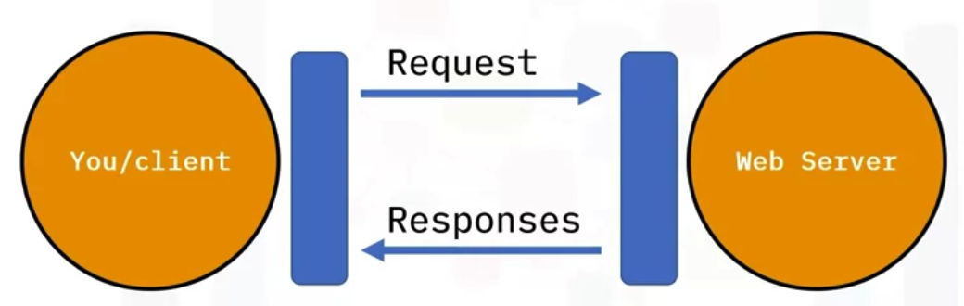
HTTP protocol
The HTTP protocol can be thought of as a general protocol of transferring information through the web
The client use a web page your browser sends an HTTP request to the server where the page is hosted. The server tries to find the desired resource by default "index.html".
The server will send the object to the client in an HTTP response
REST APIs, webscraping

Slide 4
Uniform Resource Locator- URL
URL Uniform resource locator (URL) is the most popular way to find resources on the web.
URL there are three parts:
  the scheme this is the protocol, for this lab it will always be http://
  Internet address or Base URL this will be used to find the location: www.ibm.com
  Route: this is the location on the web server: /images/IDSNlogo.png
REST APIs, webscraping

Slide 5
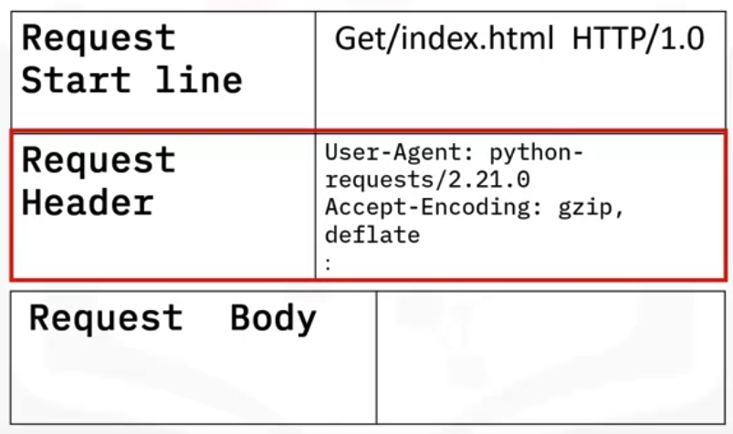
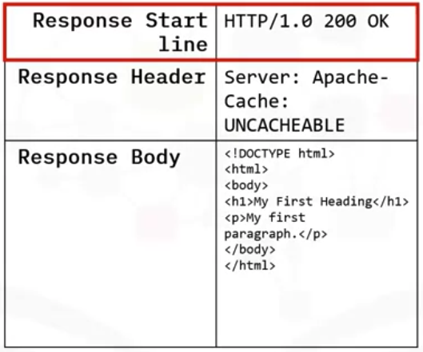
Request and Response message
REST APIs, webscraping

Slide 6
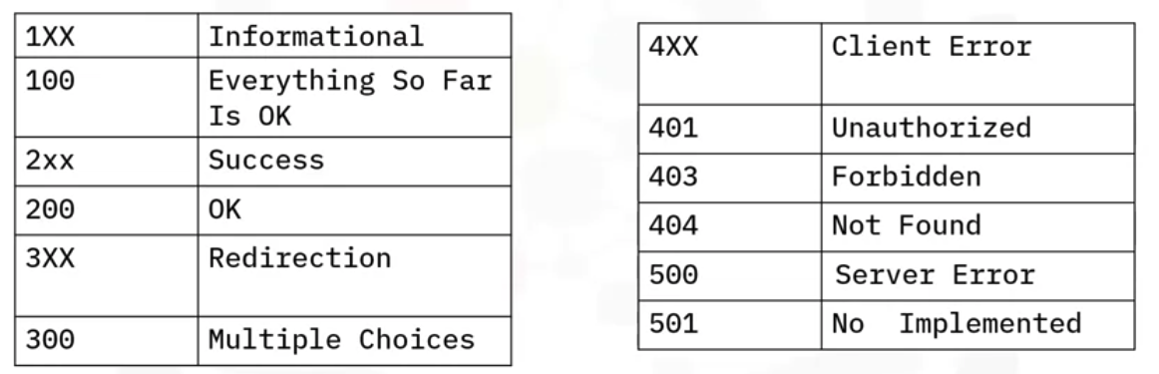
Request and Response message
Status codes
REST APIs, webscraping

Slide 7
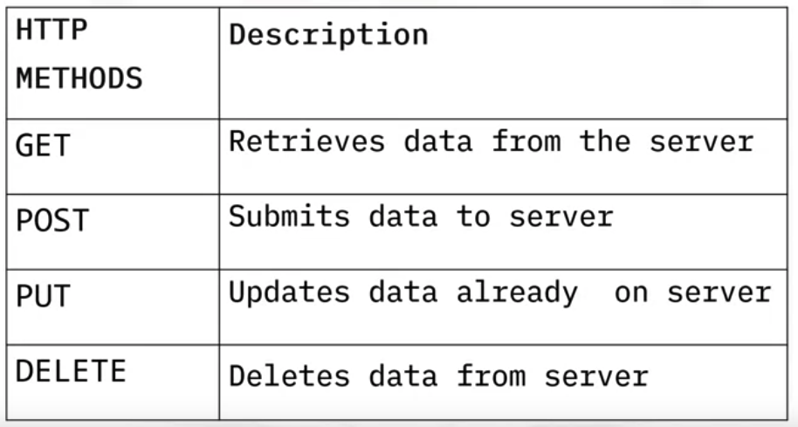
HTTP Methods
REST APIs, webscraping

Slide 8
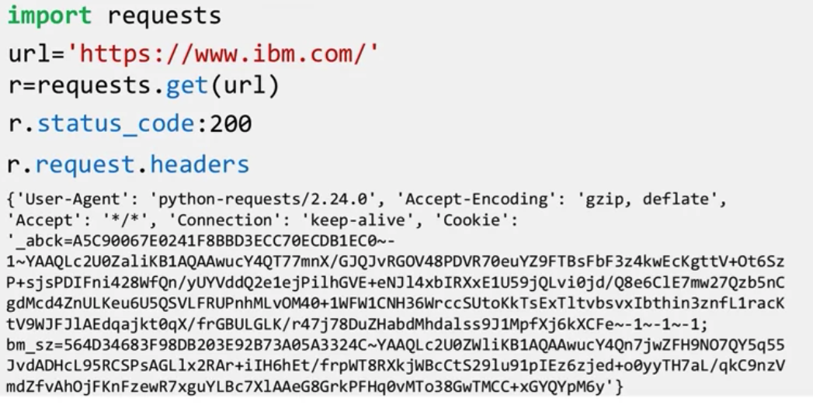
Request module
Request module is one of several libraries including: httplib, urllib, that can work with the HTTP protocol
REST APIs, webscraping

Slide 9

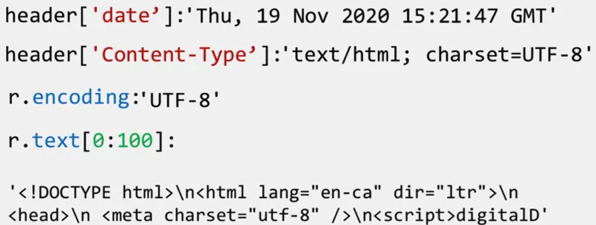
Request module
REST APIs, webscraping

Slide 10
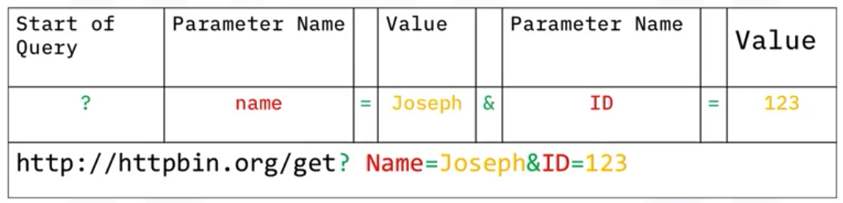
Request module
You can use the GET method to modify the results of your query.
You can send parameters to server via urlRewriting
Query string: format to send parameter to server
REST APIs, webscraping

Slide 11
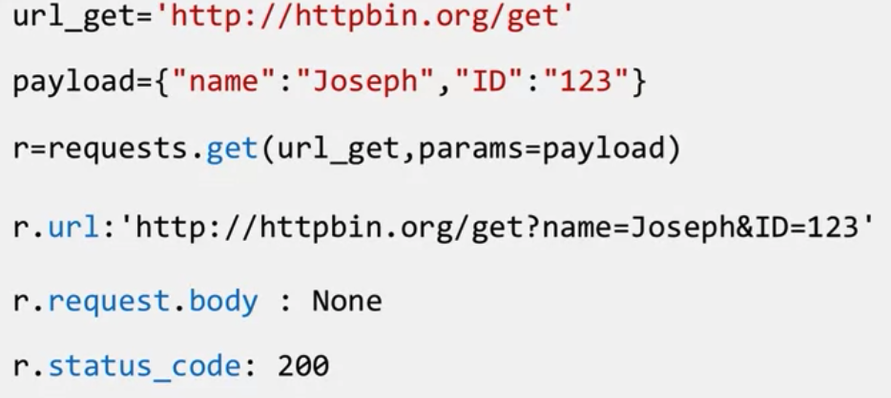
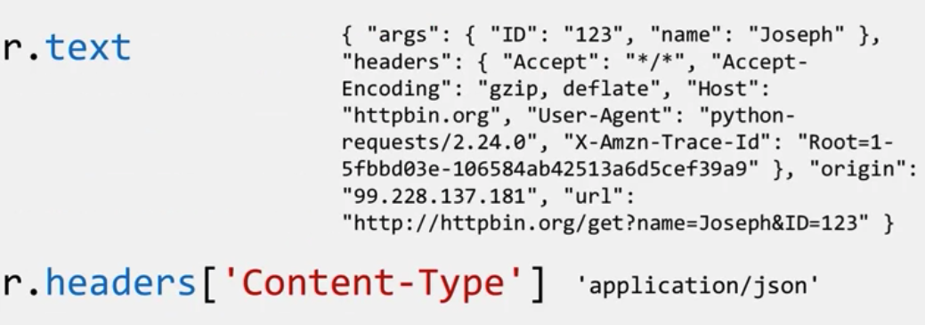
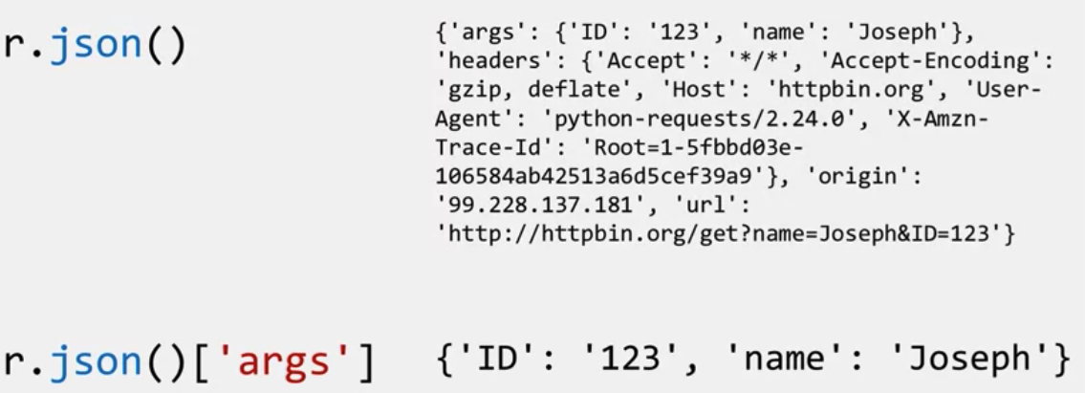
Request module
Create query string
REST APIs, webscraping

Slide 12
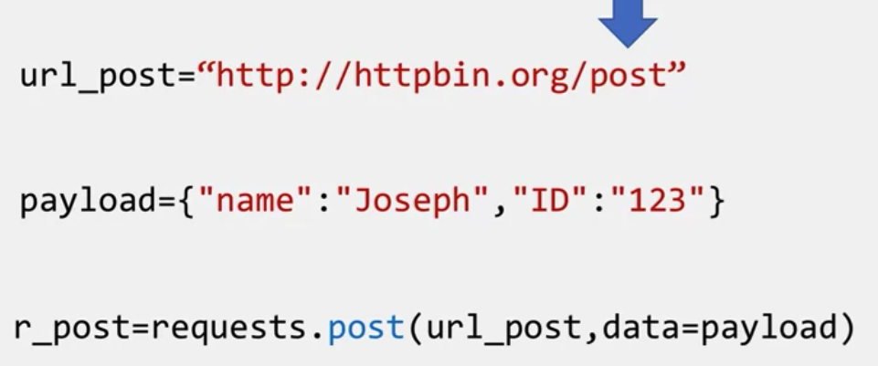
Post request
POST request is used to send data to a server, but the POST request sends the data in a request body, not the url
REST APIs, webscraping

Slide 13
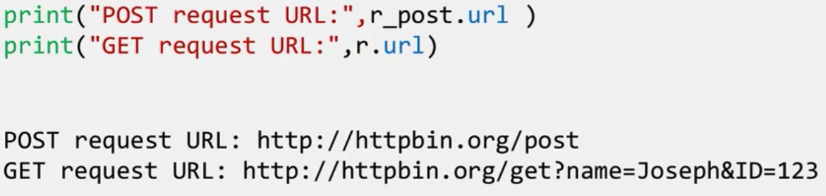
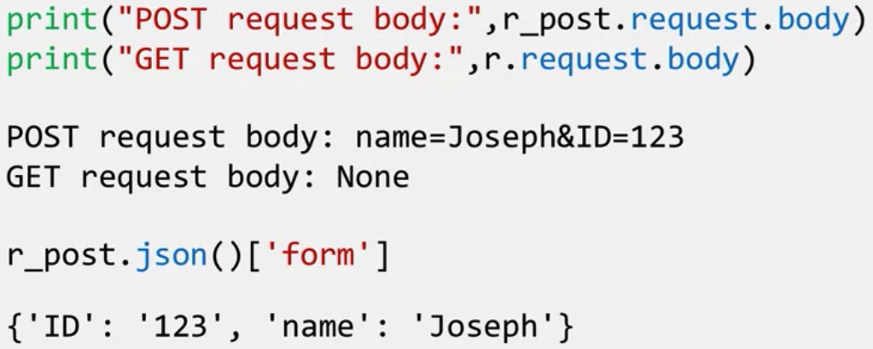
Post request
Compare POST and GET
REST APIs, webscraping

Slide 14
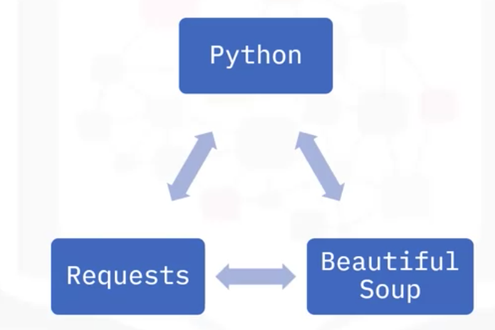
What is Webscraping?
What would you do if you wanted to analyze hundreds of points of data to find the best players of a sports team?
Would you start manually copying and pasting information from different websites into a spreadsheet?
Spending hours trying to find the right data, and eventually giving up because the task was to overwhelming?
Webscraping is a process that can be used to automatically extract information from a website, and can easily be accomplished within a matter of minutes and not hours.
REST APIs, webscraping

Slide 15
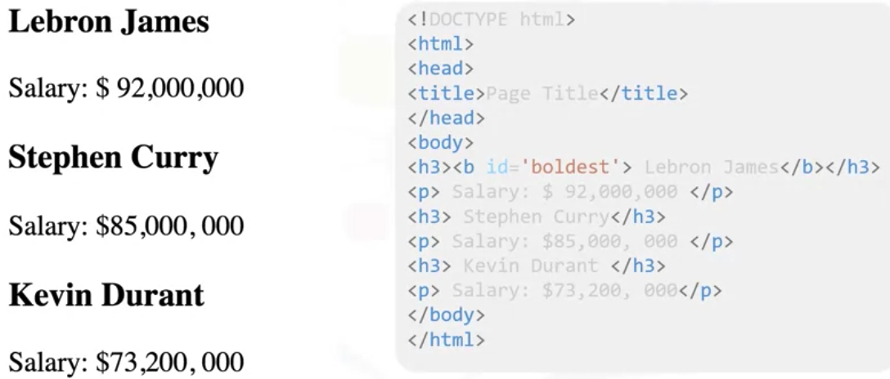
Webscraping example
You were asked to find the name and salary of players in a National Basketball League, from the following webpage.
REST APIs, webscraping

Slide 16
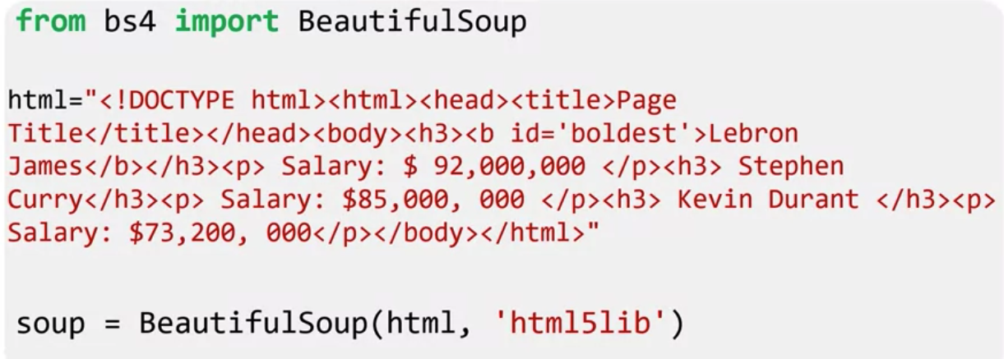
Webscraping example
We get the Beautiful Soup object , soup, which represents the document as a nested data structure.
BeautifulSoup represents HTML as a set of Tree like objects with methods used to parse the HTML.
REST APIs, webscraping

Slide 17
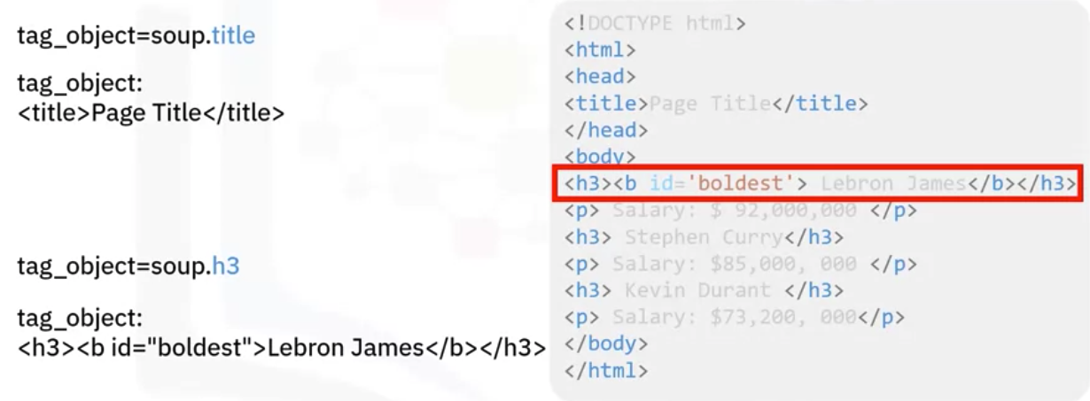
Webscraping example
Tag object
REST APIs, webscraping

Slide 18
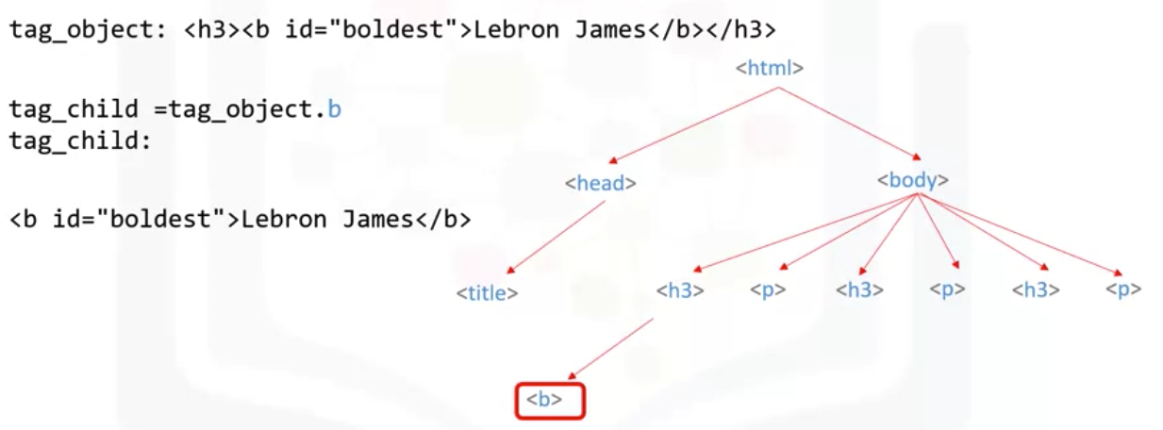
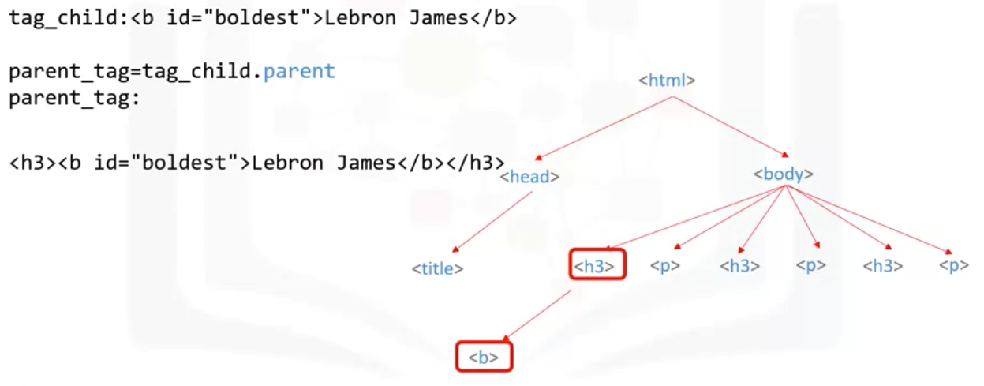
Webscraping example
We can access the child( parent) of the tag or navigate down( up) the branch
REST APIs, webscraping

Slide 19
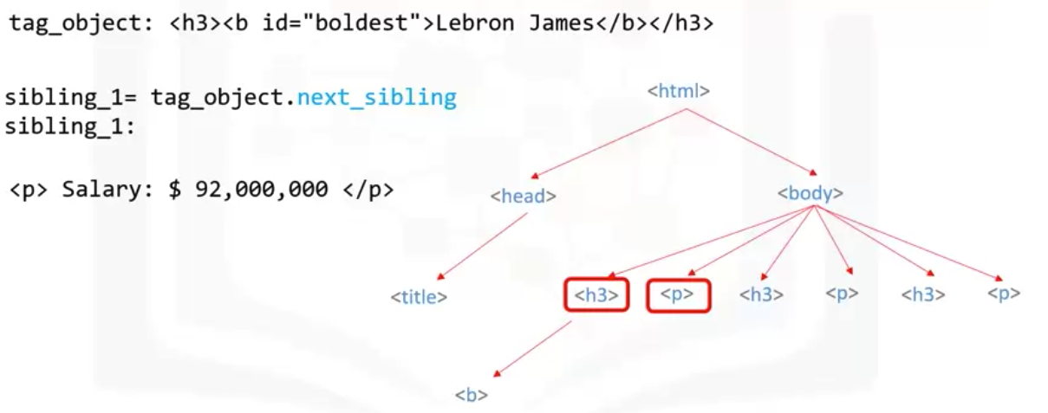
Webscraping example
We can find the sibling of “tag object.”
REST APIs, webscraping

Slide 20
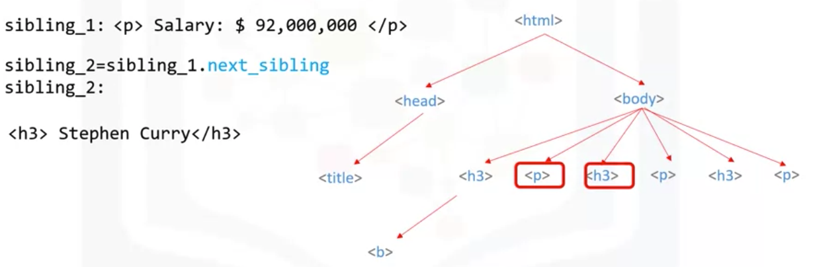
Webscraping example
We can find the sibling of sibling one
REST APIs, webscraping

Slide 21
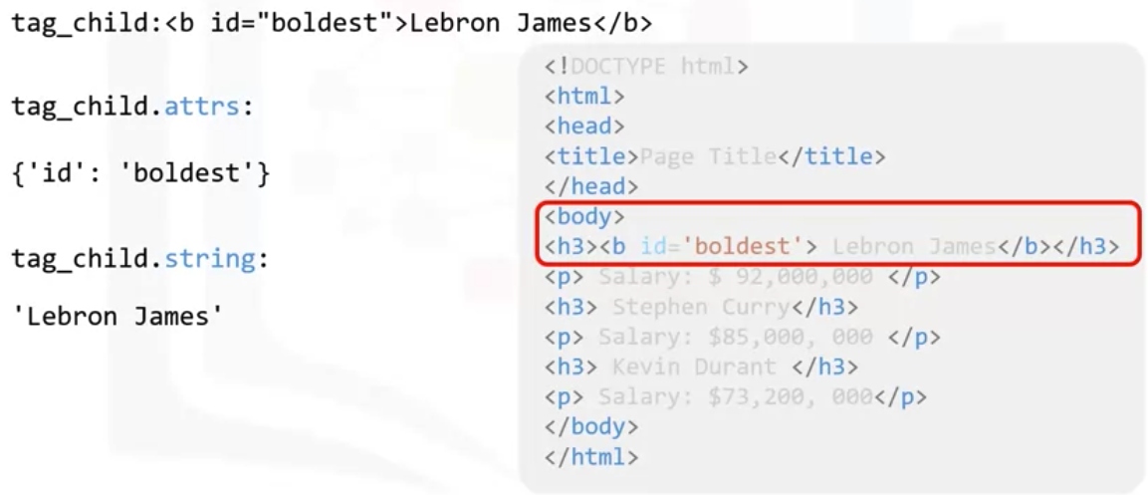
Webscraping example
You can access the attribute name and value as a key value pair in a dictionary
REST APIs, webscraping

Slide 22
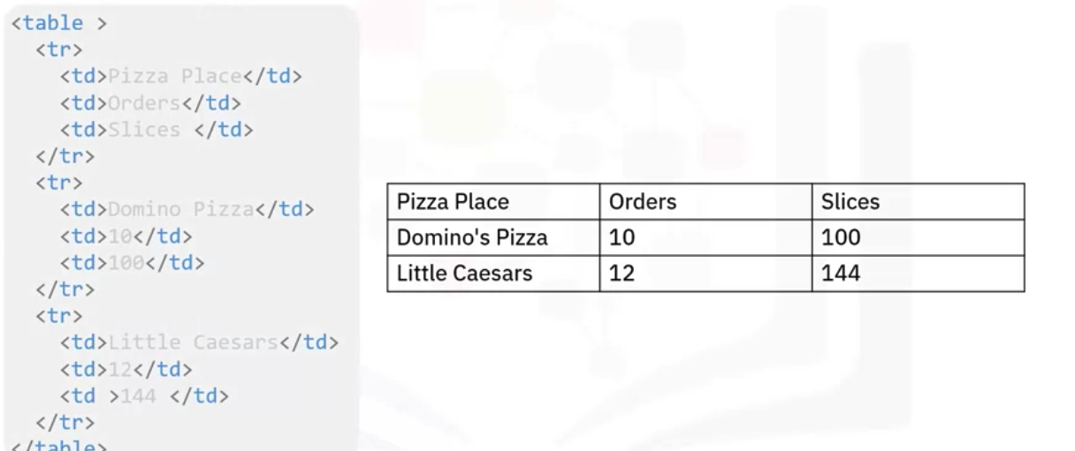
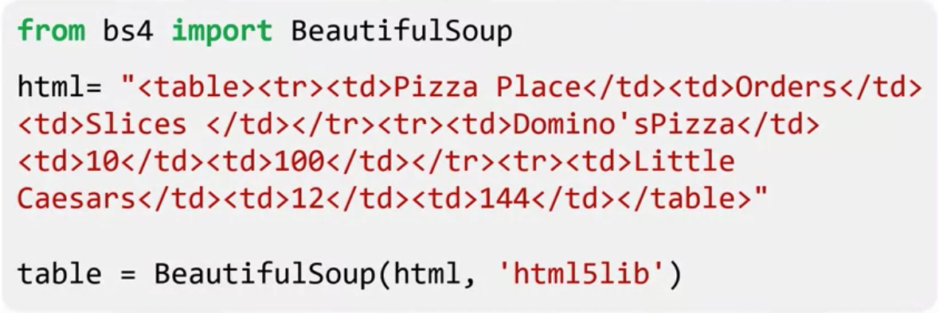
Webscraping example
find_all method is a filter, you can use filters to filter based on a tag’s name, it’s attributes, the text of a string, or on some combination of these
Example : Pizza place list
REST APIs, webscraping

Slide 23
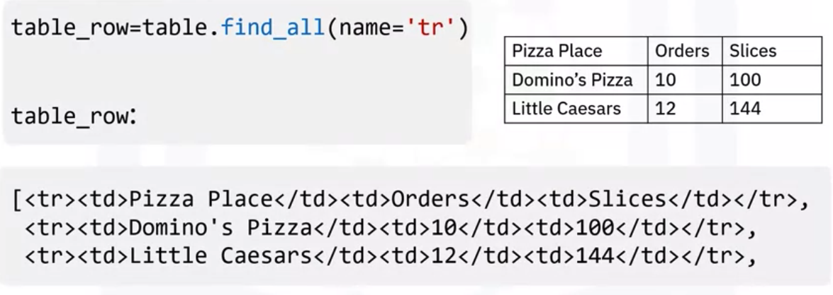
Webscraping example
The find_all () method looks through a tag’s descendants and retrieves all descendants that match your filters. Apply it to the table with the tag <tr>. The result is a Python iterable just like a list, each element is a tag object for <tr>. This corresponds to each row in the list- including the table header.
REST APIs, webscraping

Slide 24
Summary
Perform basic webscraping using Python.
Explain the difference between APIs and REST APIs.
Understand uniform Resource Locator: URL
Understand request message
Understand response message
REST APIs, webscraping

Slide 25
Q & A
REST APIs, webscraping

